Slide 1
Marketing

Slide 2
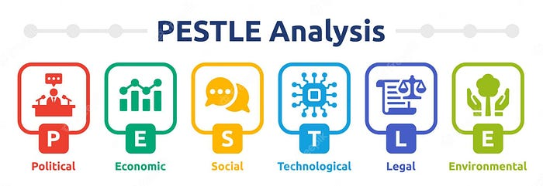

Slide 3
Political factors
Political factors relate to the political interactions between governments, countries, and various political actors. It includes:
Diplomatic relations between countries
Political stability and continuity
How governments operate
The prevalence of civil society
The potential for political unrest
Foreign trade policies

Slide 4
Economic factors
These encompass the key economic elements within the business environment that can impact your organization. it includes:
Exchange rates
Inflation
Interest rates
Economic growth rates
Corporate taxation rates
Unemployment rates

Slide 5
Social factors
Social factors or sociocultural factors define group consumer behavior and attitude. They can include quantitative indicators, such as average age, and qualitative data, such as opinions.
Demographics
Education levels
Social views
Age distribution
Disposable income
Cultural stability

Slide 6
Technological factors
Technological factors are tech-related developments, shifts, and patterns that could directly or indirectly impact your business. This can include broader global or regional conditions.
Internet connectivity
Specific technologies, like automation
Advancements in your industry
Intellectual property
Rate of technological change
Research and development lifecycles

Slide 7
Legal factors
Legal factors are current laws, regulations, and bills that may affect the organization’s operations and future plans.
Competitive regulations
Health and safety regulations
Government policy
Tax policies
Import/export laws

Slide 8
Environmental factors
Environmental or ecological factors look at the impact of businesses on the environment and how the environment might affect the business.
Natural disasters
Weather patterns
Climate change
Resource availability

Slide 9
Example: Electric Car
Political | Regulatory Framework:: In third world countries like Pakistan, political interventions can change the whole investment game of the company, it should be taken in consideration.
Economic | Rising interest rates and inflation: High inflation rates can affect the purchasing power of consumers, leading to reduced demand for cars. Changes in interest rates can impact the affordability of cars for consumers.
Social | Demographics: Pakistan's population is growing rapidly, leading to an increase in demand for cars. Income Levels and Cultural Trends: The rising income levels and increasing trend of owning a car as a status symbol in Pakistan have led to an increase in demand for cars.
Technical | Electric Vehicles and digitalization: Modern cars are computers on wheels. The increasing trend of electric vehicles globally has led to a growing demand for electric cars in Pakistan.
Environmental | Climate Change and Resource Depletion: : Climate change has led to an increase in demand for environmentally friendly cars in Pakistan. The depletion of natural resources, such as oil, has led to an increase in demand for alternative fuel cars in Pakistan.
Legal | Safety standards imposed by Govt.: Responding to a rise in the number of highway deaths, a new legislation that imposes higher safety standards is considered. This may be an opportunity to position the company as a manufacturer of safer cars.

Slide 10
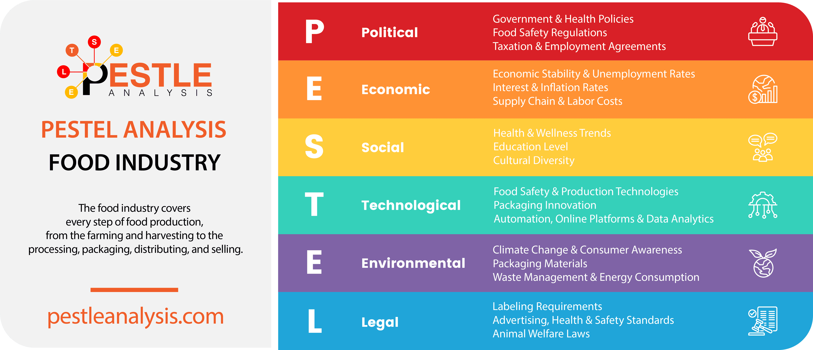

Slide 11
